Slide 1
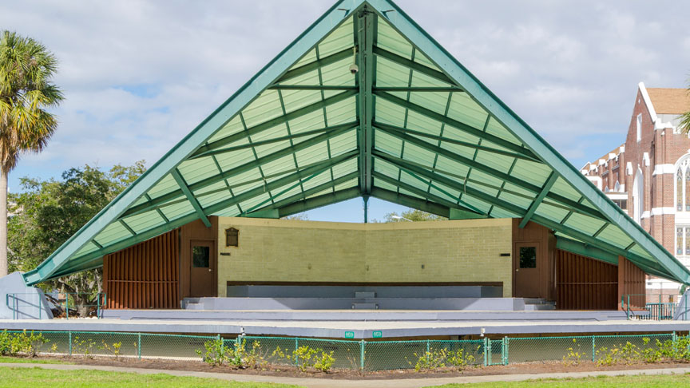

Williams Park Bandshell
Improvements

Slide 2
Existing Bandshell
Facility
  3,800 SF – Stage Area
  645 SF – Backstage Space
  610 SF – Public Restrooms
  350 SF – Storage Space
  700 SF – Crawl Space Storage

Slide 3
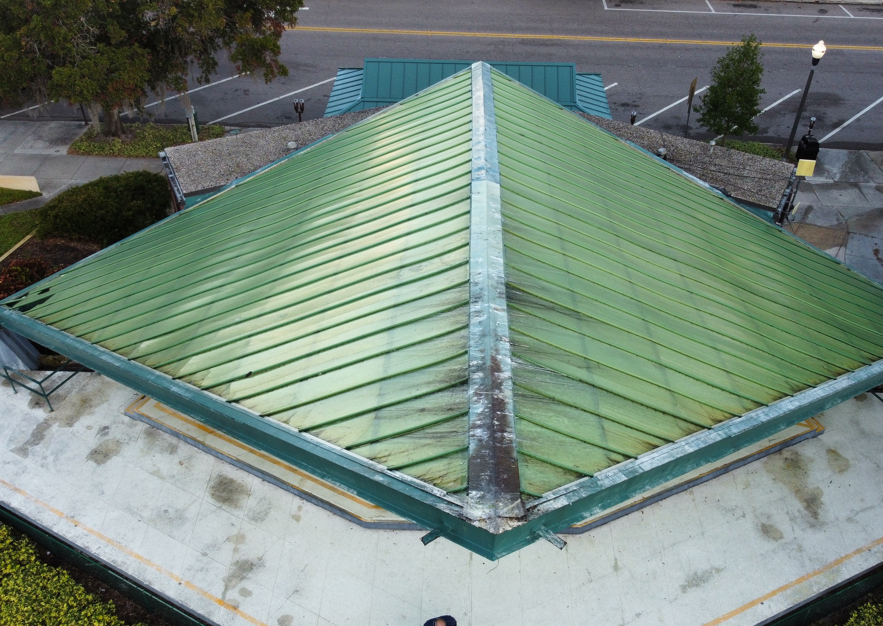
Roof Conditions
The existing roof panels are approximately 24 years old. The sun’s radiation has removed the plasticizers from the panels making them brittle and subject to damage.
The panels can be replaced using the same type of double-wall, acrylic panels, solid acrylic or polycarbonate panels (preferably with a UV cap) or use impact rated glass panels.

Slide 4
Exterior Conditions
All the existing walls need to be pressured washed, painted, and sealed. Large cracks must be repaired.
All exterior painted surfaces need to be repainted.
Patch and repair any concrete areas with existing damage.
For structural steel, remove all existing coatings down to the bare steel. Clean/remove all corrosion/rust from structural steel. Treat steel with weather protective,corrosion protective, coating prior to repainting.

Slide 5
Interior Conditions
Remove existing drywall and provide new drywall ceiling and walls. Paint and seal all surfaces
Patch and repair flooring throughout the facility. New topcoat dressing.
Replace all doors and frames throughout the facility.
Upgrade and replace electrical throughout the facility.

Slide 6
Summary
Maintenance
Costs
  $450,000 – Roof Replacement
  $300,000 – Exterior Repairs
  $150,000 – Interior Repairs
  $250,000 – Soft Costs
  $1,150,000 – Total

Slide 7
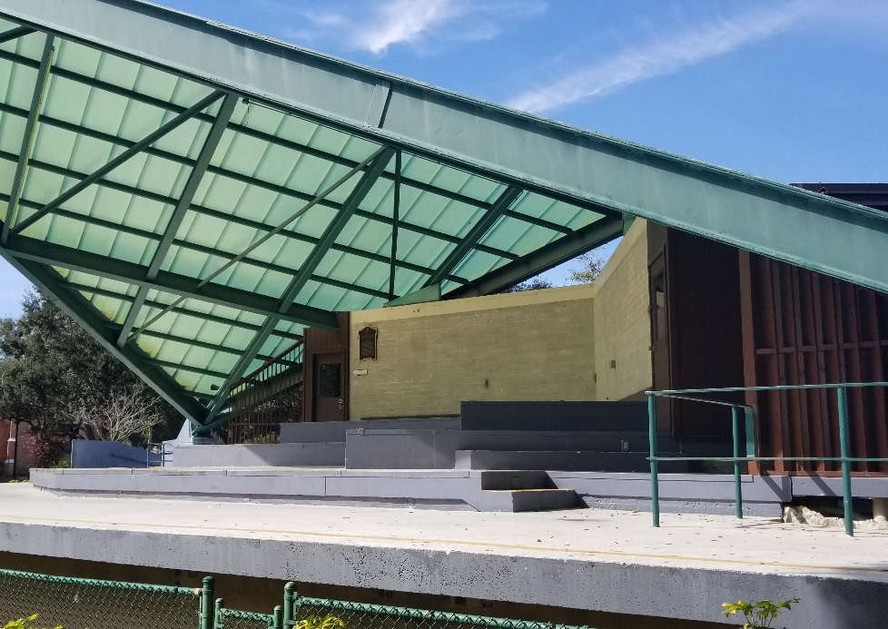
Facility Upgrades
The current bandshell does not provide important elements needed for modern performances and events. Most importantly, needed ADA improvements.
Sound system electrical, acoustical paneling, and back of house power capabilities.
Lighting improvements and controls.
Back of house upgrades include AC and restroom facility.

Slide 8
Summary
Upgrade
Costs
  $200,000 – ADA Improvements
  $160,000 – Sound System & Electrical
  $100,000 – Acoustical Upgrades
  $150,000 – Lighting
  $90,000 – Back of House
  $100,000 – Soft Costs
  $800,000 – Total

Slide 9
Thank You – Questions?

